Slide 1
CS - 571
Database Systems for BS (CS)
Lecture: Practice Questions
Dr. Khurram Shahzad
khurram@pucit.edu.pk
Punjab University College of Information Technology

Slide 2
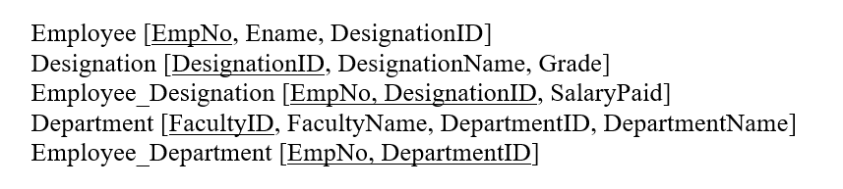
Create Table

Slide 3
Create Table
CREATE TABLE employee
(Empno NUMBER(2) PRIMARY KEY,
Ename VARCHAR2(14) NOT NULL);

Slide 4
Create Table
CREATE TABLE designation
(DesignationID NUMBER(2),
DesignationName VARCHAR2(14) NOTNULL,
Grade NUMBER (2));

Slide 5
Create Table
ALTER TABLE EMPLOYEE
ADD (DesignationID NUMBER2);

Slide 6
Create Table
CREATE TABLE employee_designation
(EmpNo NUMBER(2),
DesignationID NUMBER(2),
SalaryPaid NUMBER (2)
Constraint CFKED PRIMAY KEY (EmpNo, DesignationID),
Constraint FKDesig Foreign Key (DesignationID) REFERENCES Designation (DesignatinID),
Constraint FKEmp Foreign Key (Empno) REFERENCES Employee(EMPNO);

Slide 7
Select Command
Find the designation names whose grades are not yet assigned.

Slide 8
Select Command
Find the designation names whose grades are not yet assigned.
Select Designation
From Designation
Where Grade is NULL

Slide 9
Select Command
How much would be the salary each employeeID, if the salary he receives is doubled.

Slide 10
Select Command
How much would be the salary of each employee whose ID is above 100, if the salary he receives is doubled.
Select SalaryPaid*2 Double_Salary
From Employee_Designation
Where Employee > 100;

Slide 11
Select Command
Show the names of employees and their designation in the following format. Khurram is working as Assist Prof

Slide 12
Select Command
Show the names of employees and their designation in the following format. Khurram is working as Assist Prof
Select Ename || ‘is working as’ || DesignationName
From Employee E, Designation D
Where E.EmpNo = D.DesignationID;

Slide 13
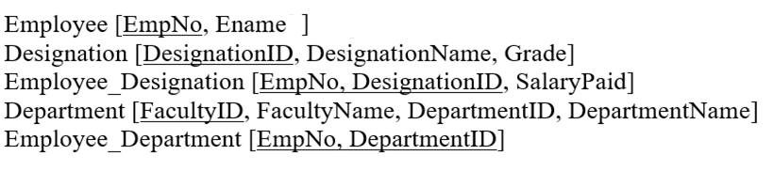
Select Command
Show the Names and designation of the employees who are Lecturers, Assistant Professor or Associate Professor.

Slide 14
Select Command
Show the Names and designation of the employees who are Lecturers, Assistant Professor or Associate Professor.
Select Ename, DesignationName
From Employee E, Designation D, Employee_Designation ED
Where E.EmpNo = ED.EmpNo
AND ED.EmpNo = DesignationID
Where DesignationName IN (‘Lectures’, ‘Assistant Professor’, ‘Associate Professor’);

Slide 15
Select Command
Show the Department names of the employees, whose salaries are between 100,000 and 200,000.

Slide 16
Select Command
Show the Department names of the employees, whose salaries are between 100,000 and 200,000.
Select DepartmentName
From Department D, Employee_Department ED, Employee E, Employee_Designation EmpD, Designation DES
Where D.DepartmentID = ED.DepartmentID
AND ED.EmpNo = E.EmpNo
And E.EmpNo = DES.DesignationID …
AND SalaryPaid Between 100,000 and 200,000;

Slide 17
Select Command
Show the names of the employees whose names start with K.

Slide 18
Select Command
Show the names of the employees whose names start with K.
Select EName
From Employee
Where Ename like ‘K%’

Slide 19
Select Command (Decode)
Show the employees and their salary by applying increase using the following formula, 7% if they are lecturers, 5% if they are assistant Professor and 2% otherwise.

Slide 20
Select Command (Decode)
Show the employees and their salary by applying increase using the following formula, 7% if they are lecturers, 5% if they are assistant Professor and 2% otherwise.

Slide 21
Select Command (Decode)
Show the employees and their salary by applying increase using the following formula, 7% if they are lecturers, 5% if they are assistant Professor and 2% otherwise.
Select Ename, DECODE (DesignationName, ‘Lecturer’, SalaryPaid*1.7,
‘Assistant Professor’, SalaryPaid*1.5, SalaryPaid*1.2)
From Employee E, Designation D
Where E.EmpNo = D.DesignationID;

Slide 22
Select Command
Compute the total salary paid by the institute each year.

Slide 23
Select Command
Compute the total salary paid by the institute each year.
Select Sum(SalaryPaid*12)
From Employee_Designation

Slide 24
Select Command
Compute the total salary paid by the each department of the institute along with the department name.

Slide 25
Select Command
Compute the total salary paid by the each department of the institute along with the department name.
Select DepartmentName, Sum(SalaryPaid*12)
From Department D, Employee_Department ED, Employee E, Employee_Designation EMPD
Where D.DepartmentID = ED.EmpNO
AND E. EmpNo = ED.EmpNo
AND Desig.DesignatoinID = E.EmpNo
Group by Department ID / DepartmentName;

Slide 26
Select Command
Generate the list of all employees their respective designations and all designations.

Slide 27
Select Command
Generate the list of all employees (names only) their respective designations and all designations (names only).
Select Ename, DesignationName
From Employee E, Employee_Designation ED, Designation D
Where E. EmpNo = ED.EmpNo (+)
AND ED.DesignatoinID = D.DesignationID (+);

